Slide 1
An Analytic Framework for Human Computation
Professor Chris Callison-Burch

Slide 2
Notes:
Abstract away from the particulars of Amazon Mechanical Turk, and work through an analytic framework for human computation

Slide 3
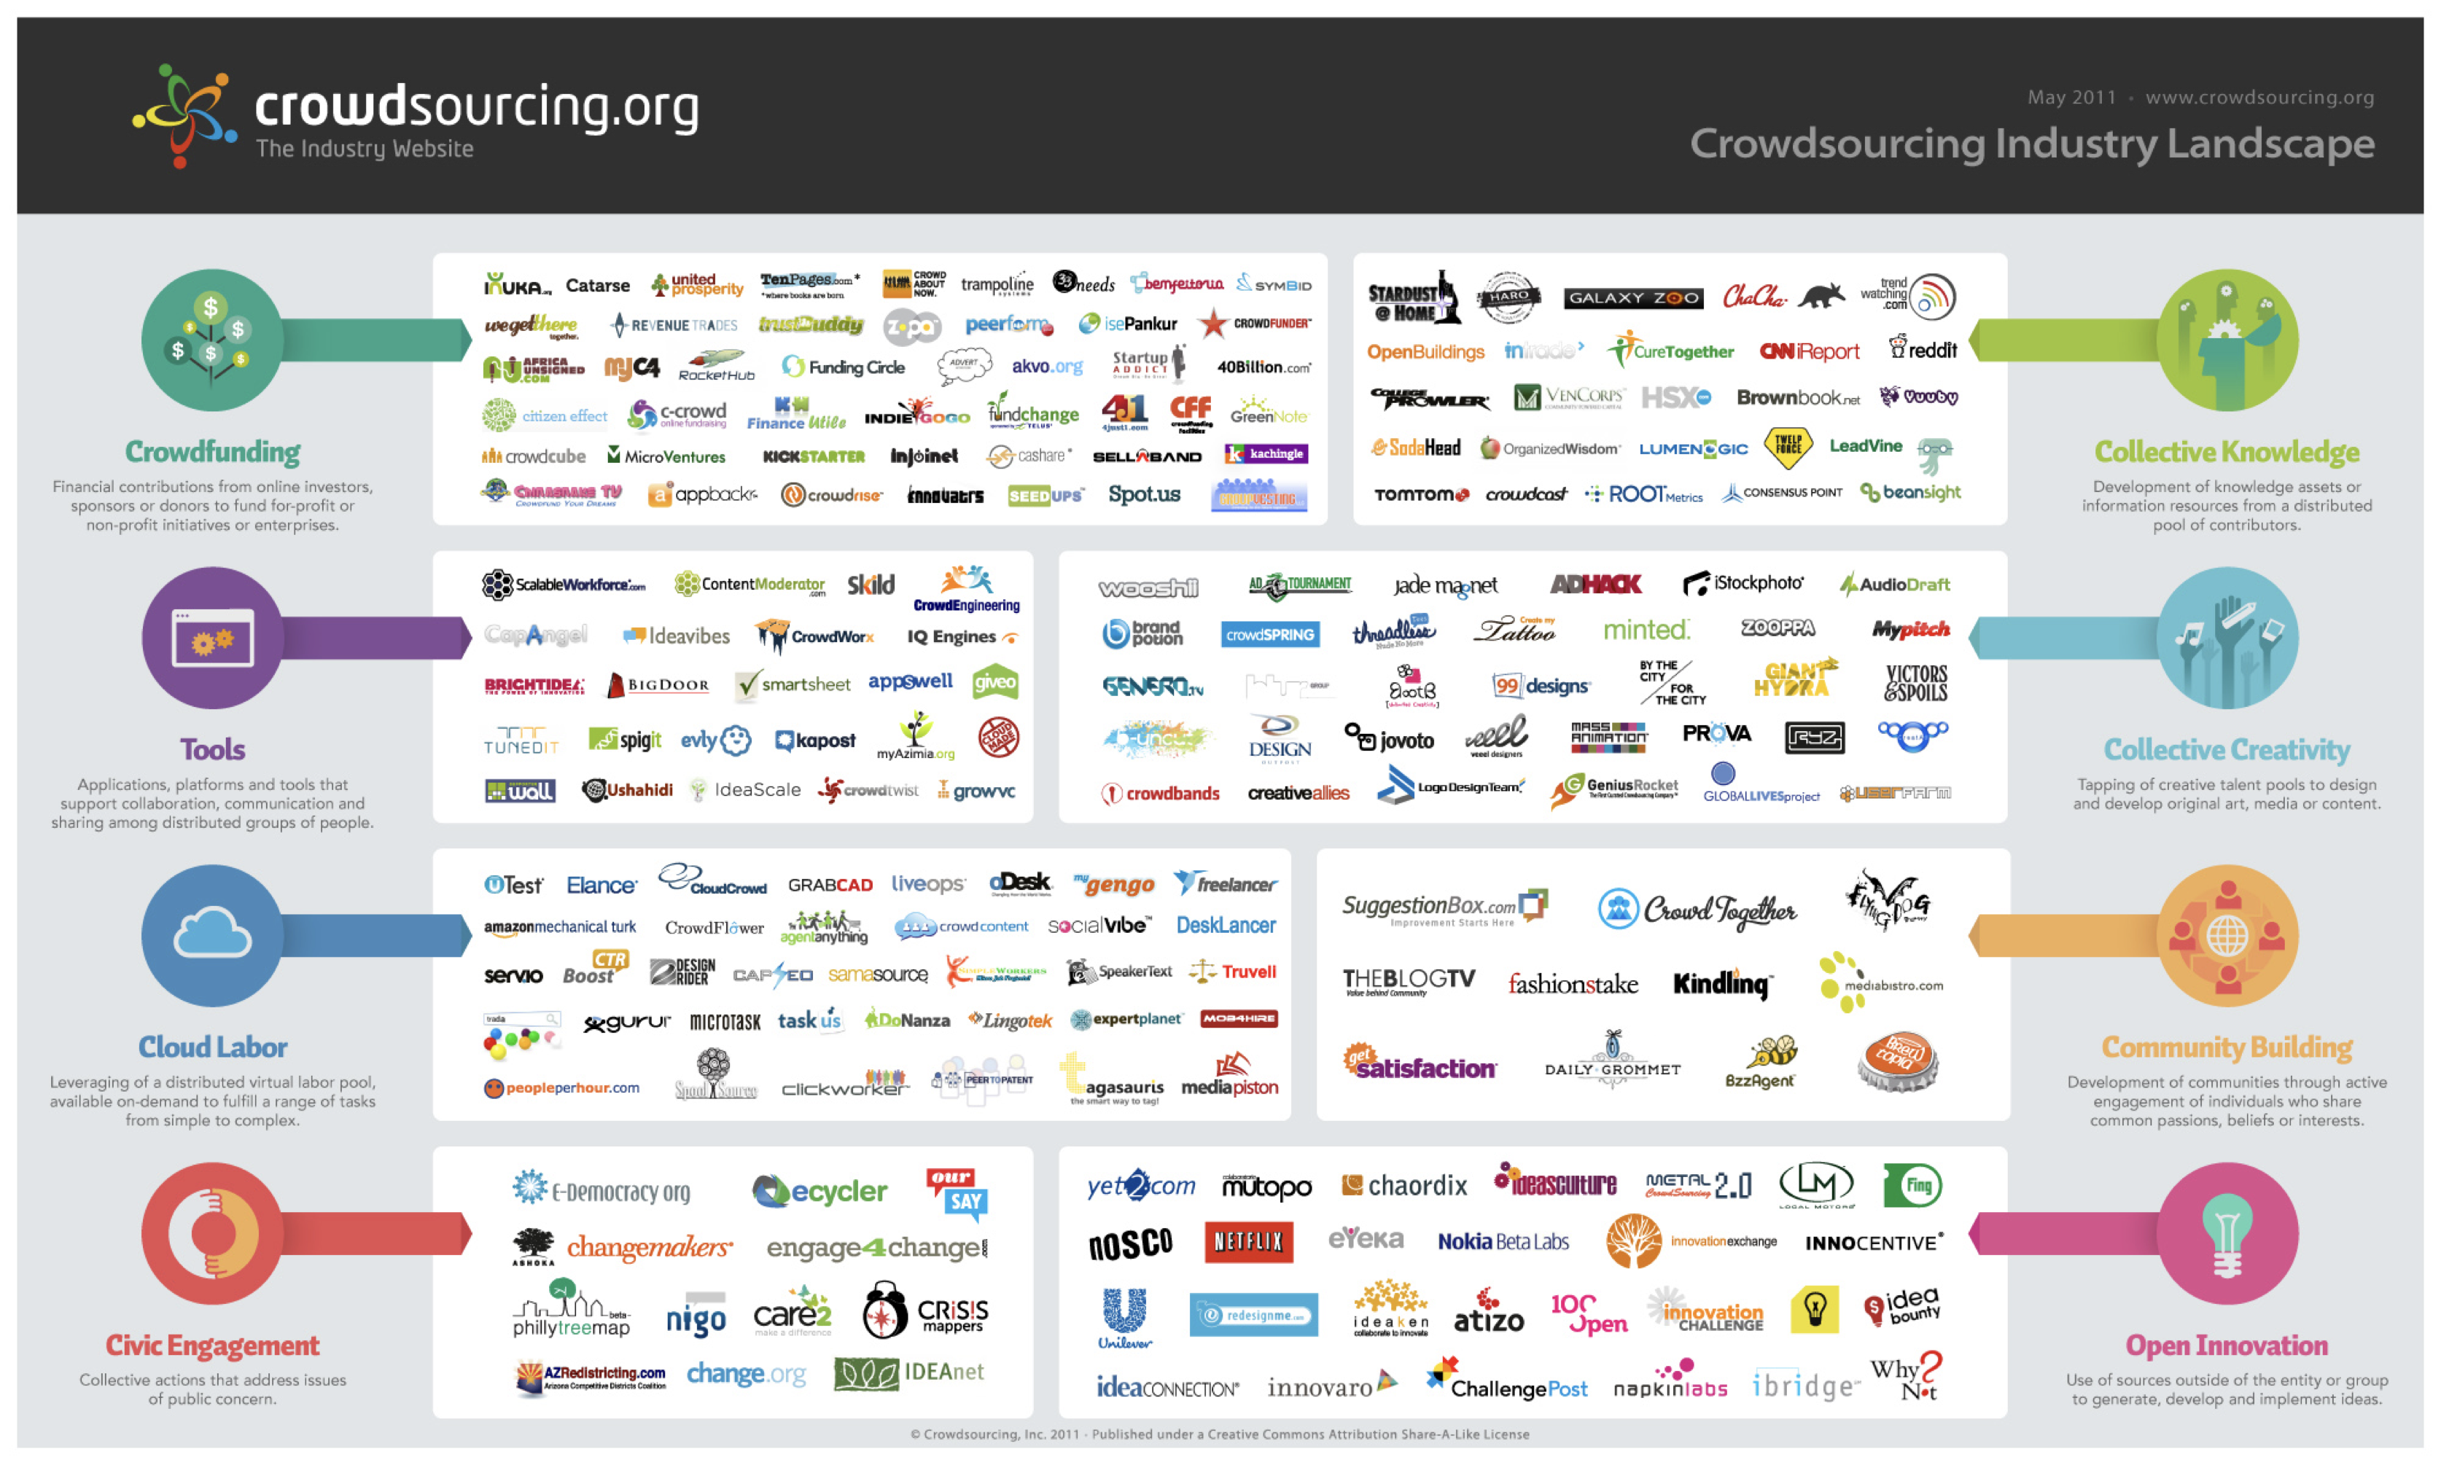
Notes:
CrowdFunding, CrowdLabor, CivicEngagement, Collective Creativity, Community Building, Open Innovation

Slide 4
Classification System for Human Computation
Motivation
Quality Control
Aggregation
Human Skill
Process Order
Task-request Cardinality

Slide 5
Motivation
How can we motivate people to participate?
Even with a low barrier to entry (anyone with an computer can contribute) we still need to make a case why they should contribute.
Notes:
One of the challenges in any human computation system is finding a way to motivate people to participate. This is eased somewhat by the fact that most human computation systems rely on networks of unrelated people with connected computers in their homes or workplaces. They need not go anywhere or do anything too far out of their ordinary lives to participate. Even so, since the computations frequently involve small unit tasks that do not directly benefit the contributors, they will only participate if they have a motivation—a reason why doing the tasks is more beneficial to them than not doing them. Unlike a traditional job, which almost always pays with money, human computation workers may be motivated by a number of factors. Still, some workers are paid, so we start there

Slide 6
Motivation: Pay
Easiest way to recruit workers.
Downside: provides incentive to cheat
Problem might be exacerbated when the crowd workers are anonymous
MTurk uses micropayments
Online temping services provide higher wages: LiveOps, ODesk, etc
CrowdFlower tried non-monetary payments (virtual goods and currencies, SwagBucks)
Notes:
LiveOps [40] is a company that employs workers online to handle phone calls for businesses, as a sort of distributed call-center. The workers follow scripts, which makes the job analogous to an automated telephone system, a role that might otherwise be filled by a computer.

Slide 7
Motivation: Altruism
People want to do good
When Jim Gray went missing, volunteers searched 500k satellite images
After the Haitian earthquake, diaspora translated 1000 messages per day

Slide 9
Eske lekol kolej marie anne kraze?mesi | Was the College Marie Anne school destroyed? Thank you.
Nou pa ka anpeche moustik yo mo`de nou paske yo anpil. | We can’t prevent the mosquitoes from biting because there are so many.
tanpri ke`m ap kase mwen pa ka pran nouvel manmanm. | Please heart is breaking because I have no news of my mother.
4636:OpitalMedesensanFwontie`delmas19lafe`men. Opital sen lwi gonzag nan delma 33 pran an chaj gratwit- man tout moun ki malad ou blese | 4636: The Doctors without Borders Hospital in Delmas 19 is closed. The Saint Louis Gonzaga hospital in Delmas 33 is taking in sick and wounded people for free

Slide 10
Motivation: Reputation
Sometimes people will contribute in order to build their profile within a community
Example: stackoverflow

Slide 11
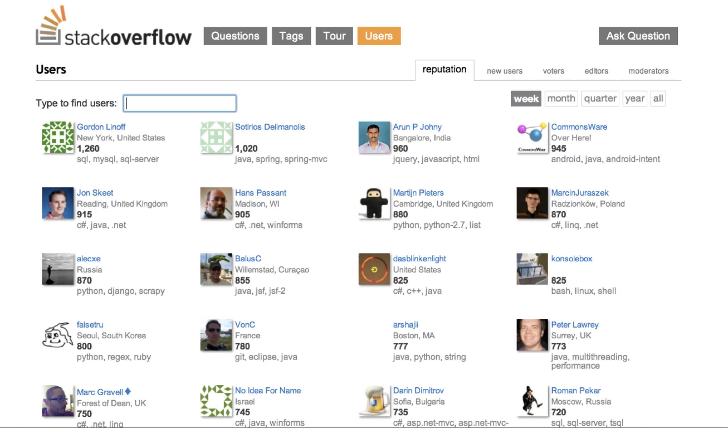

Slide 12
Motivation: Enjoyment
Games with a purpose is a strategy to try to make a task fun
In the ESP game two players look at an image and try to guess what words the other is thinking
In doing so they label images on the web

Slide 13
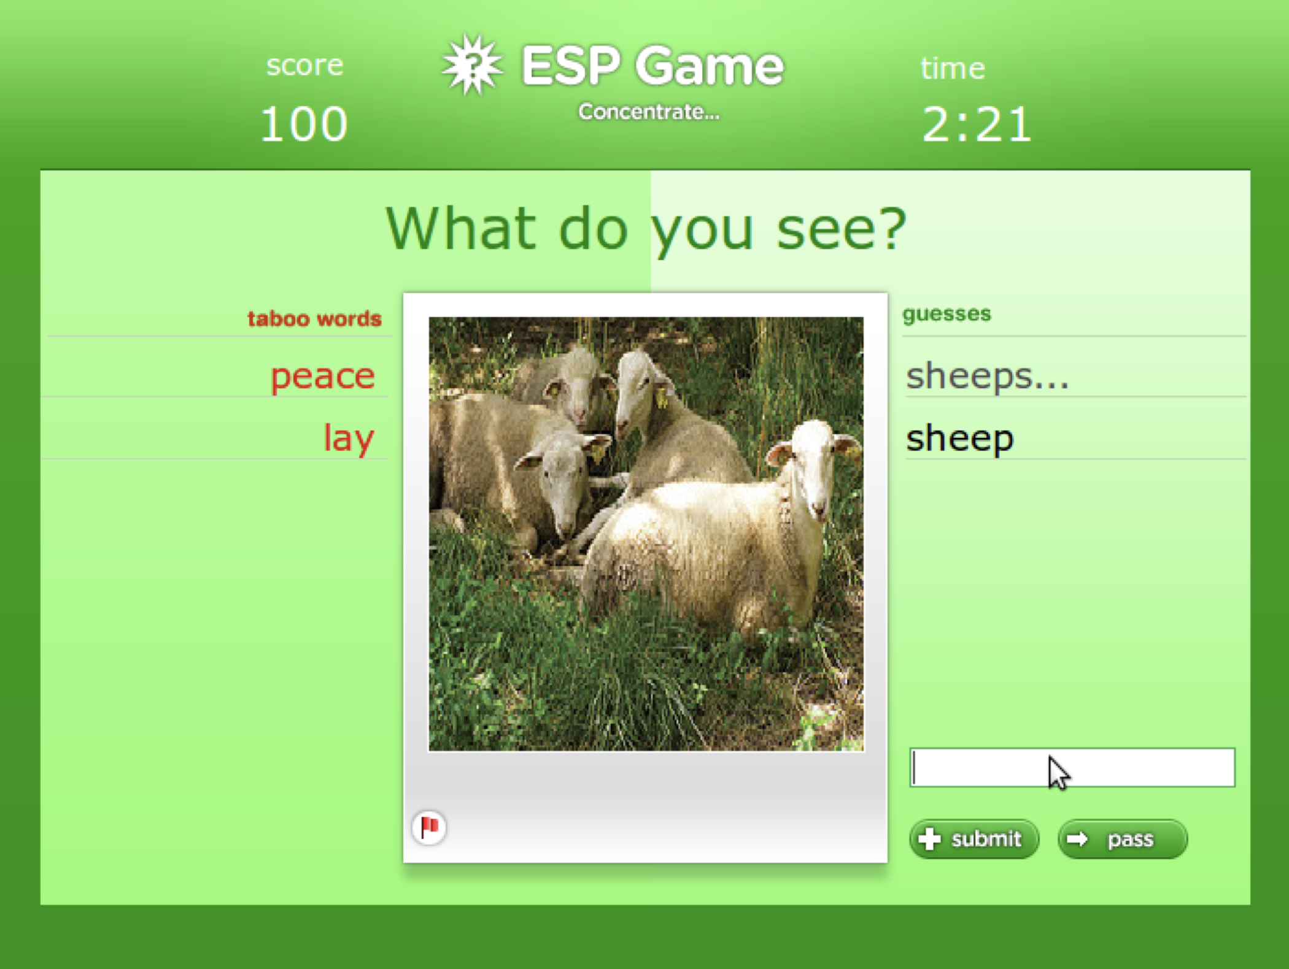

Slide 14
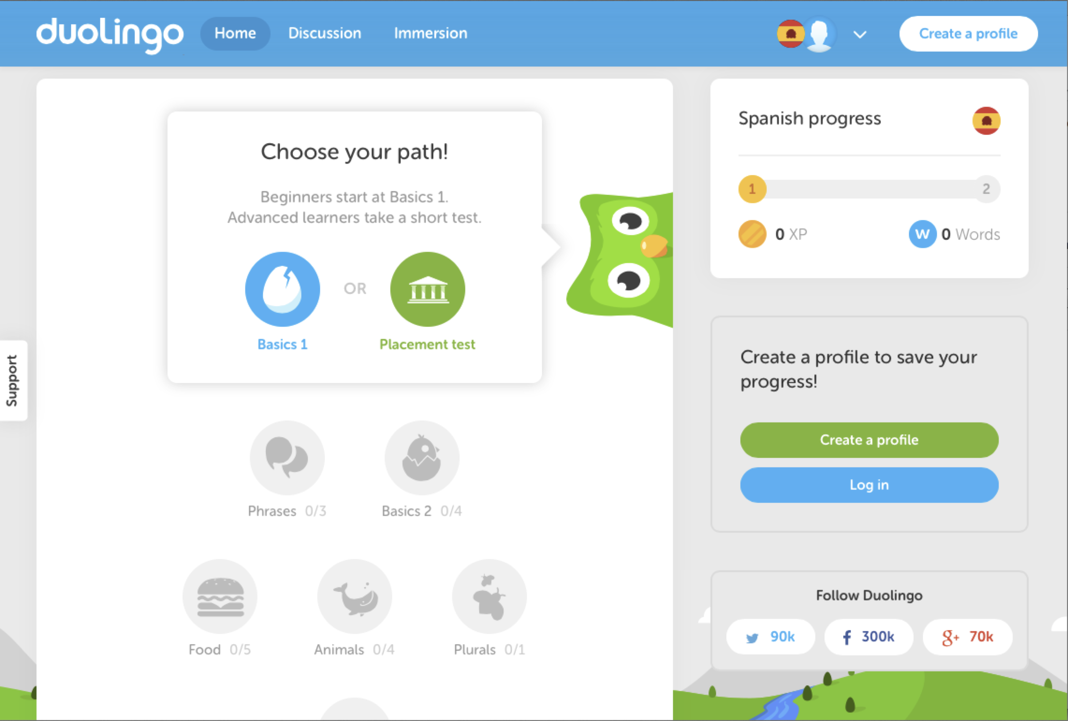

Slide 15
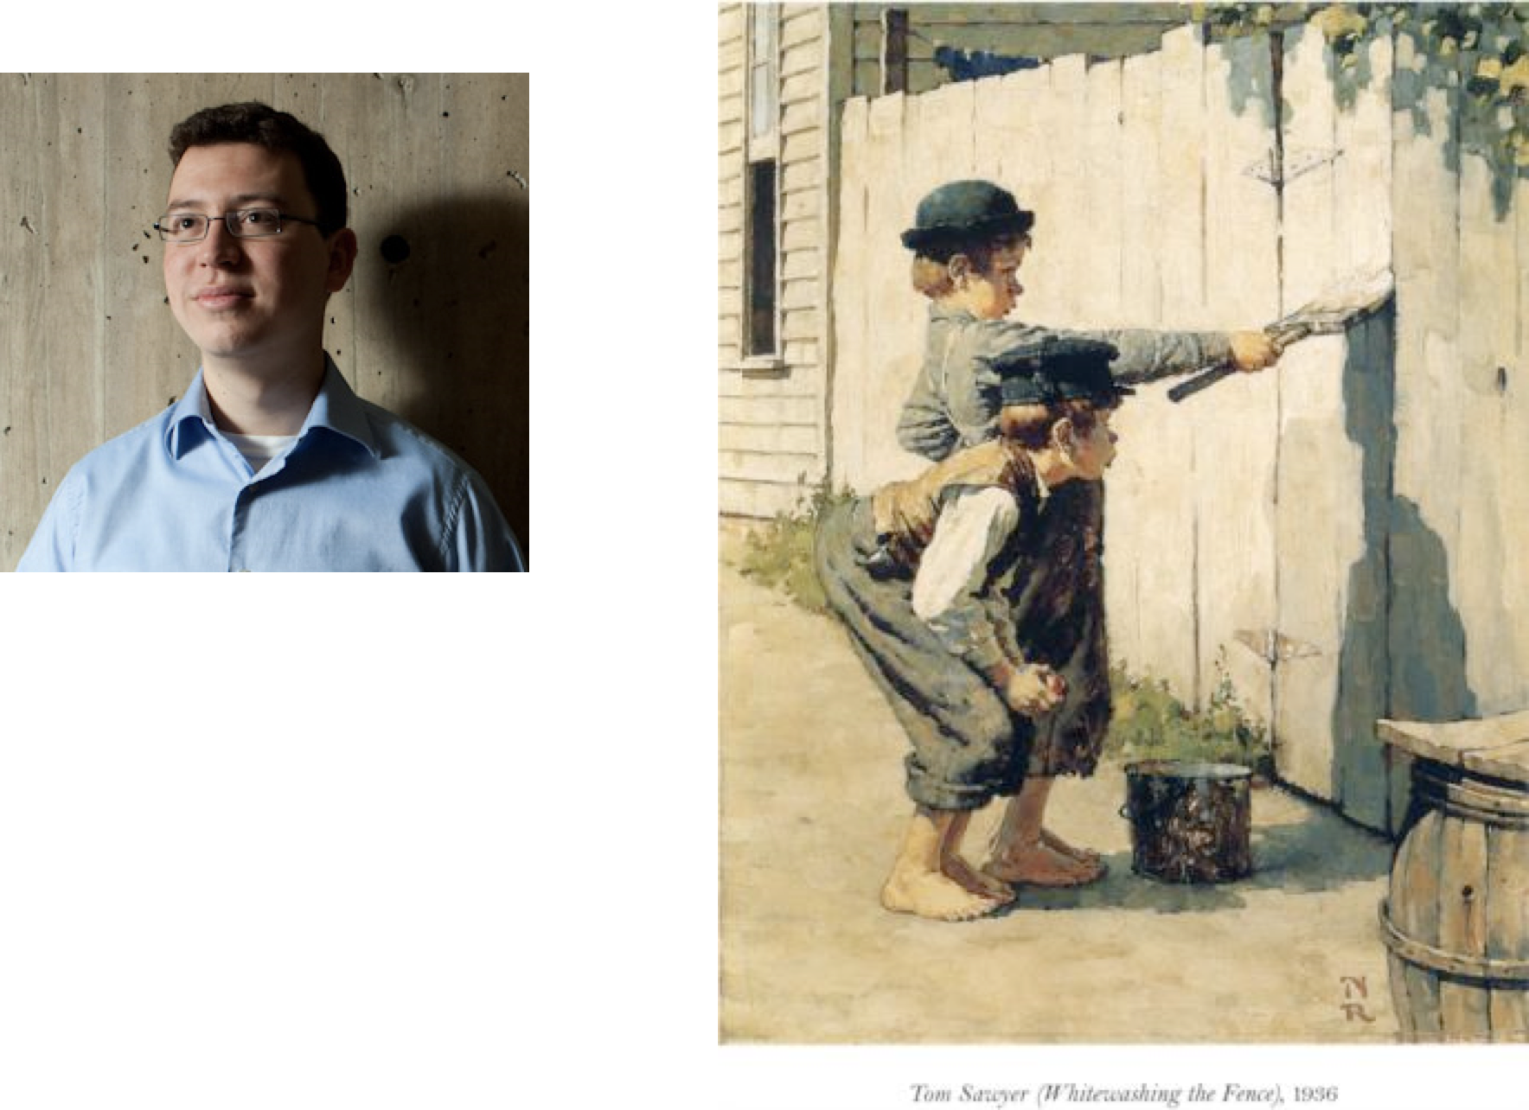
Luis Von Ahn
==
Tom Sawyer

Slide 16
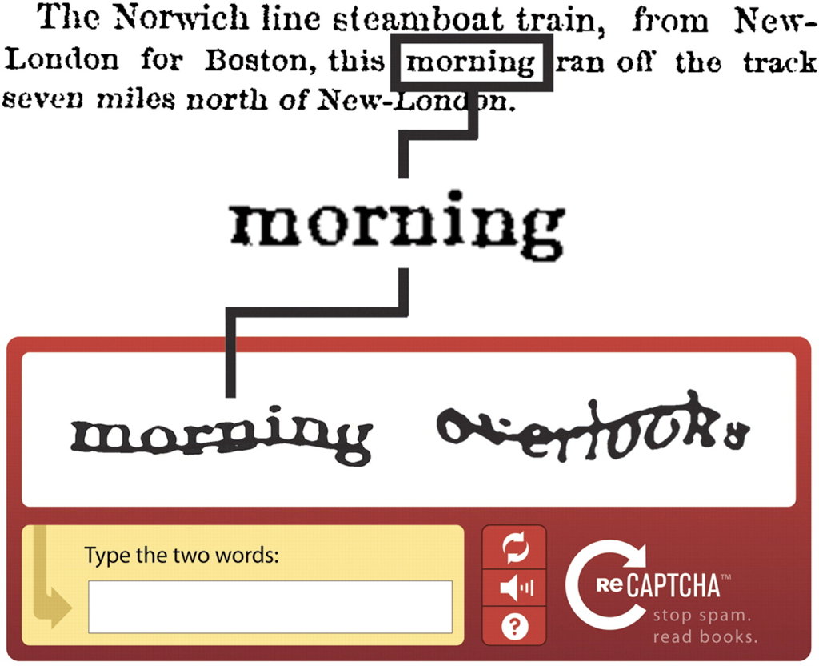
Motivation: Implicit Work
It is sometimes possible to make people do work alongside some other task

Slide 17
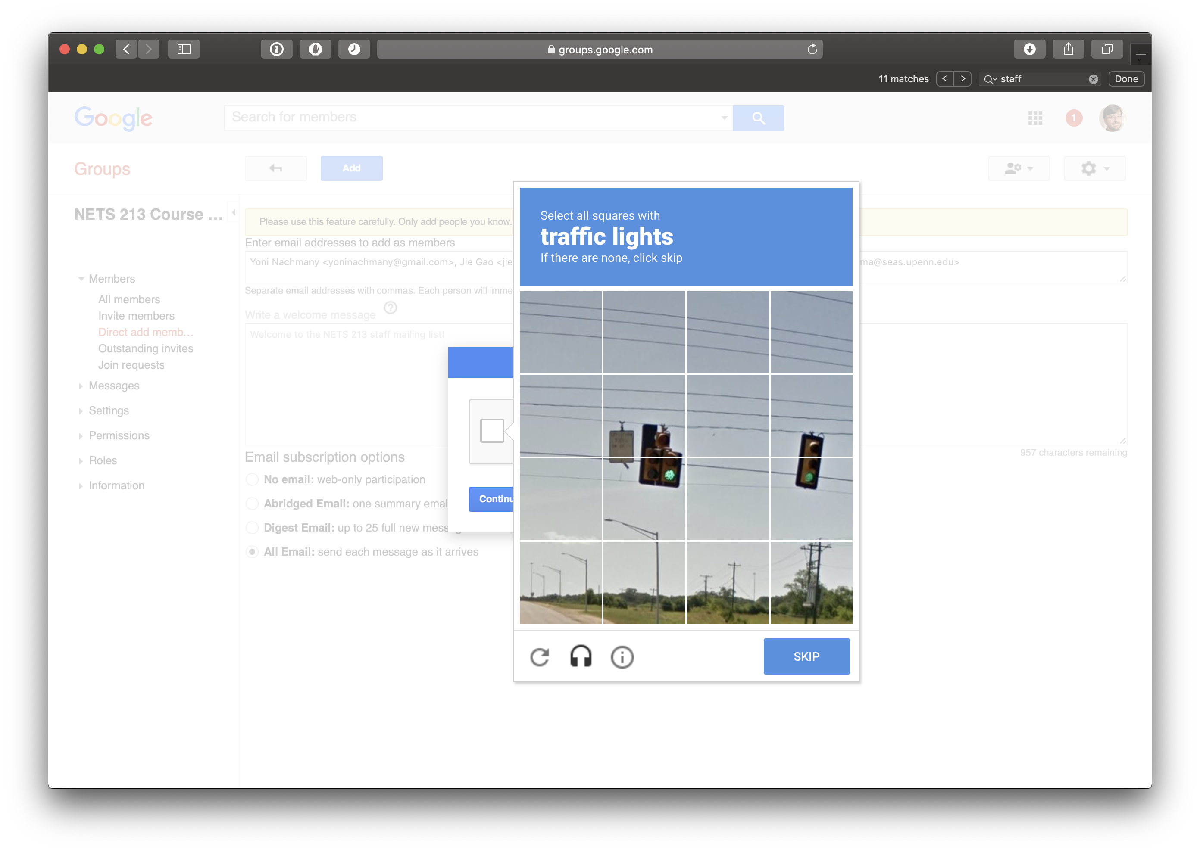

Slide 18
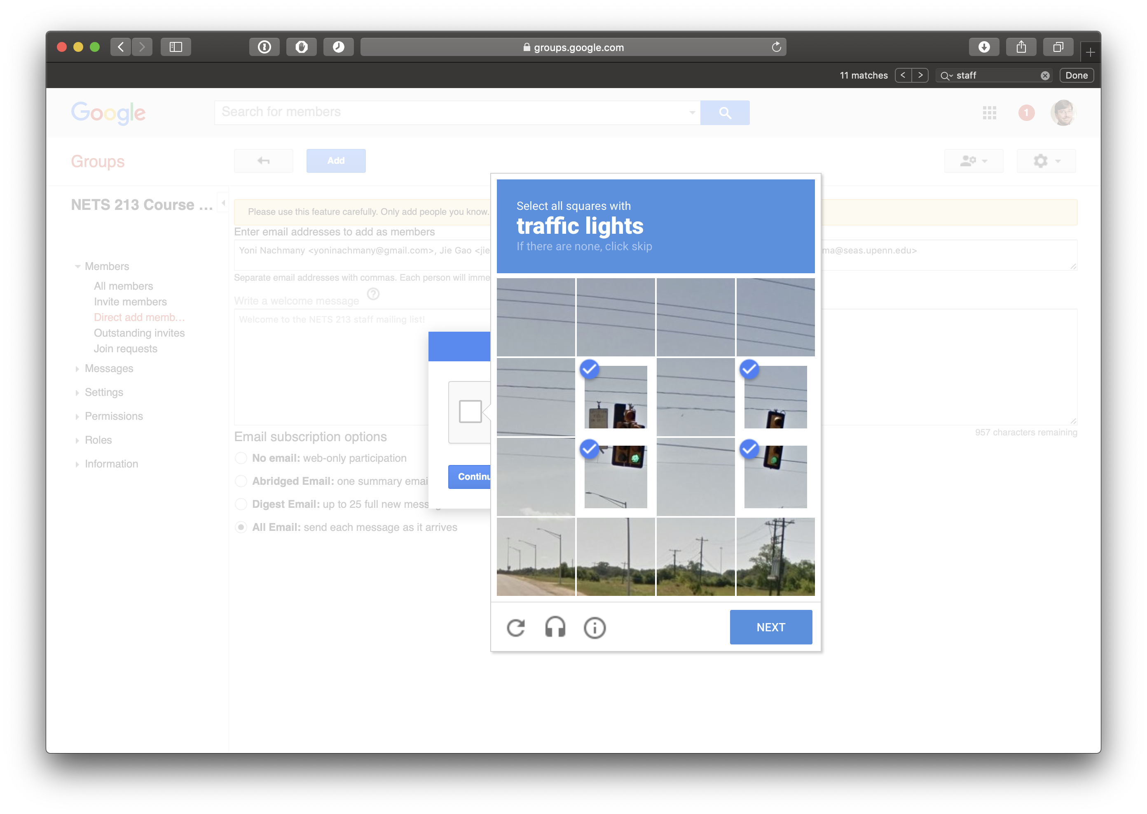

Slide 19
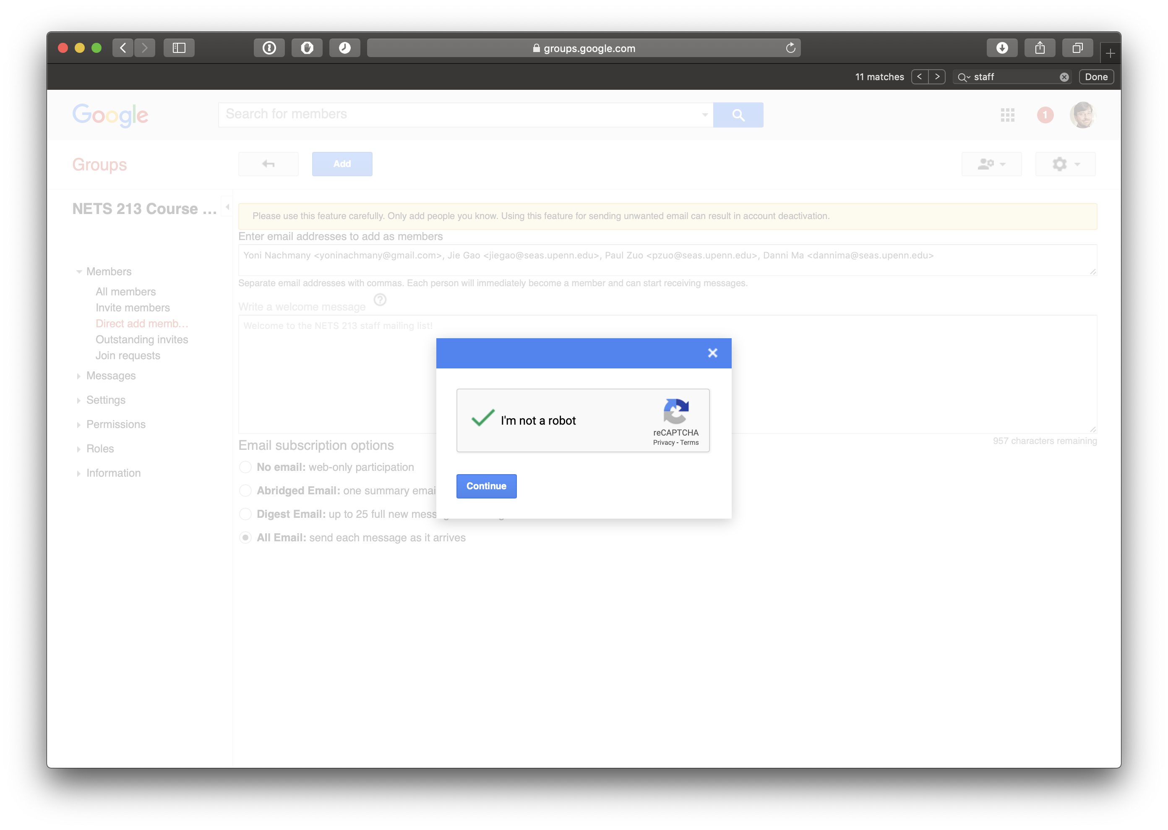

Slide 20
Motivation
Pay
Altruism
Reputation
Enjoyment
Implicit Work
Can you think of others?

Slide 21
Quality Control
Even if people are motivated to participate, how do we know that they are doing work conscientiously?
Can we trust them not to cheat or sabotage the system?
Even if they are acting in good faith, how do we know that they’re doing things right?
Notes:
They might misunderstand the directions or make mistakes due to personal bias or lack of experience with the subject matter.

Slide 22
Quality Control: Reputation Check
Mechanical Turk uses a reputation system
When a Turker submits poor work, Requesters reject it
The Turker’s approval rate is displayed to all other Requesters

Slide 23
QC: Agreement and Redundancy
The ESP game uses the labels that two players independently agree on
Similar technique is often used in MTurk, when each item is done independently
Redundancy allows a voting on ambiuous answers / opinions
It is also helpful for identifying workers who are consistently divergent

Slide 24
QC: Gold Standard
In MTurk we commonly mix in questions with a known answer alongside new questions
This is similar to agreement, but now we check agreement against experts or trusted workers
For multiple choice questions, gold standard allows for automatic grading

Slide 25
QC: Second-pass review
Do second-pass grading when gold standard don’t allow automatic grading
Often times the second-pass HIT can be automatically gradable
This makes the whole pipeline fully automated and ensures high quailty

Slide 26
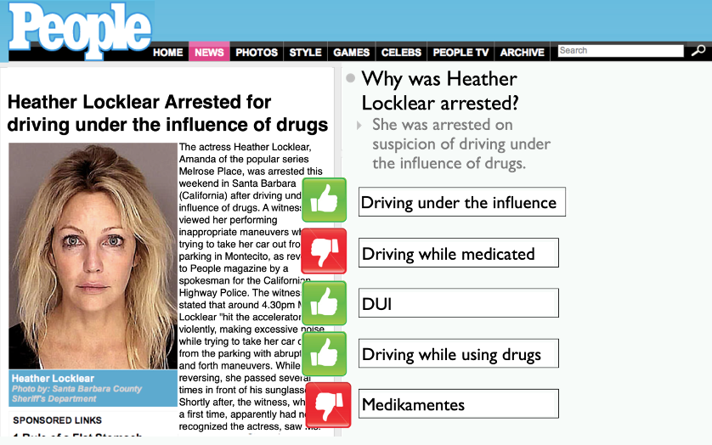

Slide 27
QC: Defensive task design
Try to design tasks so that they are nearly as hard to cheat as they are to complete
For my translation HITs, people frequently would paste text into Google Translate
I converted the text into images, then people had to transcribe it.

Slide 28
QC: Statistical models
Sometimes it is possible to have prior knowledge about what the range of expected answers should be
Use your statistical knowledge to throw out outliers
Notes:
ccb - todo - read what these guys did:
Chen, K., Wu, C., Chang, Y., & Lei, C. A crowdsourceable QoE evaluation framework for multimedia content.

Slide 29
QC: Economic incentives
When money is the motivator, it may be possible to use different incentive structures to illicit better results
Pay people more when they reach a certain level of mastery, or when their output passes second pass reviews
CastingWords uses bonuses to do this

Slide 30
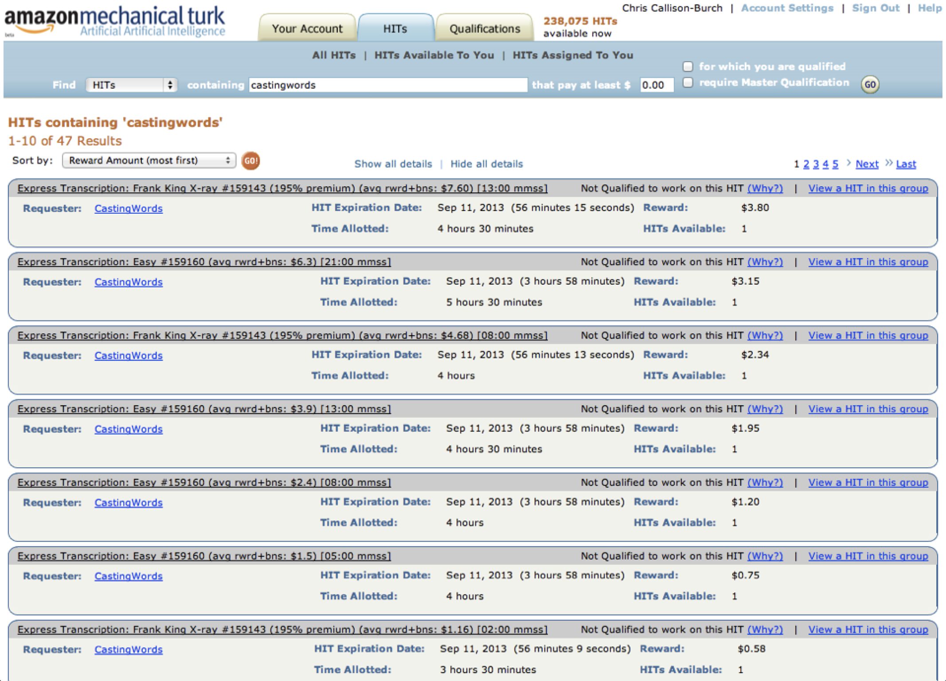

Slide 31
Quality Control
Reputation check
Agreement and redundancy
Gold standard + automatic reviewing
Multi-level review
Defensive task design
Statistical filtering
Economic incentives
Others?

Slide 32
Aggregation
Part of the process of human computation is to combine all contributions to solve a global problem.
The class of problem may determine what strategy is best.

Slide 33
Aggregation: Statistical Data Processing
In Wisdom of Crowds, Surowiecki argues that aggregating answers from a decentralized, disorganized group of people, all thinking independently yields more accurate answers than from individuals.
Individual errors need to be uniformly distributed, so individual judgments must be made independently.
Notes:
Several online polling web sites and prediction markets harness this concept to not only determine a group opinion, but to try to predict future events [72] (e.g. Ask500People [1], News Futures [46], and Iowa Electronic Markets [26]). While prediction markets are not examples of human computation, they are one of the most commonly cited examples of Wisdom of Crowds.
ccb - todo - shout out to ML that aggregates over committees of learners. Bayes.

Slide 34
Aggregation: Collection
Voting
Prediction markets

Slide 35
Aggregation: Collection
Sometimes aggregation collects discrete facts in a knowledge base
A contribution may
add a new fact
improve quality by correcting, refuting, or confirming existing facts

Slide 36
Notes:
Knowledge Collection from Volunteer Contributors (KCVC) is kind of human computation that uses the collection method of aggregation. KCVC is summarized in [13]. The goal is to advance artificial intelligence research by using humans to build large databases of common sense facts. The idea is that humans, by way of their child development and adult lives, acquire a great deal of common sense knowledge (i.e. ―People cannot brush their hair with a table.‖).
or FACTory [60], Verbosity [67], 1001 Paraphrases [12]) or by plain volunteerism (e.g. Learner [11], Open Mind Common Sense [58]).

Slide 37
Aggregation: Search
Some human computation paradigms are simply asking people to find something in a large number of images
Stardust@home project - people looked through images of aerogel to find dust from comet’s tail gathered by spacecraft
Notes:
Searches for Jim Gray, Steve Fosset

Slide 39
Aggregation: Iterative Refinement
One person’s output is shown to the next person, who is asked to improve upon it
What would Surowiecki say? (WWSS?)

Slide 42
Aggregation
Wisdom of Crowds
Collection
Search
Iterative improvement
Genetic algorithm
None?
Other?
Notes:
Genetic algorithms: key functions of initialization, mutation, and recombinant crossover

Slide 43
Human Skill
“Human Computation is a paradigm for utilizing human processing power to solve problems that computers cannot yet solve.“
– Luis von Ahn. Doctoral Thesis, 2005.

Slide 44
Human Skill
What human skills have we seen so far?
What others might be used for human computation tasks?
Notes:
Visual recognition
Language understanding
Translation
Reasoning

Slide 45
Process order
Three roles in Human Computation: Requester, Worker, Computer
Requester is the end user who benefits from the computation
Worker is the person performing the task
Computer only comes into play when it plays a role in solving the problem (not just aggregating results or being the information channel)

Slide 46
Process Order: CWR
Computer ➔ Worker ➔ Requester
In reCAPTCHA:
Computer first tries to perform OCR
Workers are presented with words that it fails to recognize
Their transcriptions are aggregated for the Requester (reader / library)

Slide 47
Process Order: WRC
Worker ➔ Requester ➔ Computer
In image labeling games:
Players (workers) provide labels
Web users (requesters) perform an image search
Computer searches the database of labels and presents matches

Slide 48
Process Order: CWRC
Computer➔Worker➔Requester➔Computer
Cyc system has inferred a lot of facts by analyzing text
Sends its guesses to FACTory where Workers confirm/correct facts
When a user (requester) queries Cyc
The Cyc system performs AI inference

Slide 49
Process Order: RW
Requester ➔ Worker
Some tasks require no (non-human) computation
Audio transcription or text dictation
For small jobs, might not need any sophisticated computer-mediated QC
Notes:
Just spot check the output

Slide 50
Task-Request Cardinality
When a service is powered by human computation, many human workers may produce the result.
Sometimes, just one or a few workers may suffice. The structure of the problem dictates the cardinality.
Notes:
Cardinality is a key dimension in classifying human computation systems, as well as analyzing the financial or time requirements of any given system.

Slide 51
Task-Request Cardinality
One-to-one: ChaCha question answering
Many-to-many: Image labeling / search
Many-to-one: Search for Jim Gray
Few-to-one: VizWiz has a few people respond to each blind person’s query

Slide 52
Opportunities for Growth in HComp
Dimensions: Motivation, Quality Control, Aggregation, Human Skill, Process Order, Task-Request Cardinality
Consider new pairings of dimensions
Invent new values for dimensions
Classify new work and consider variations

